Slide 1
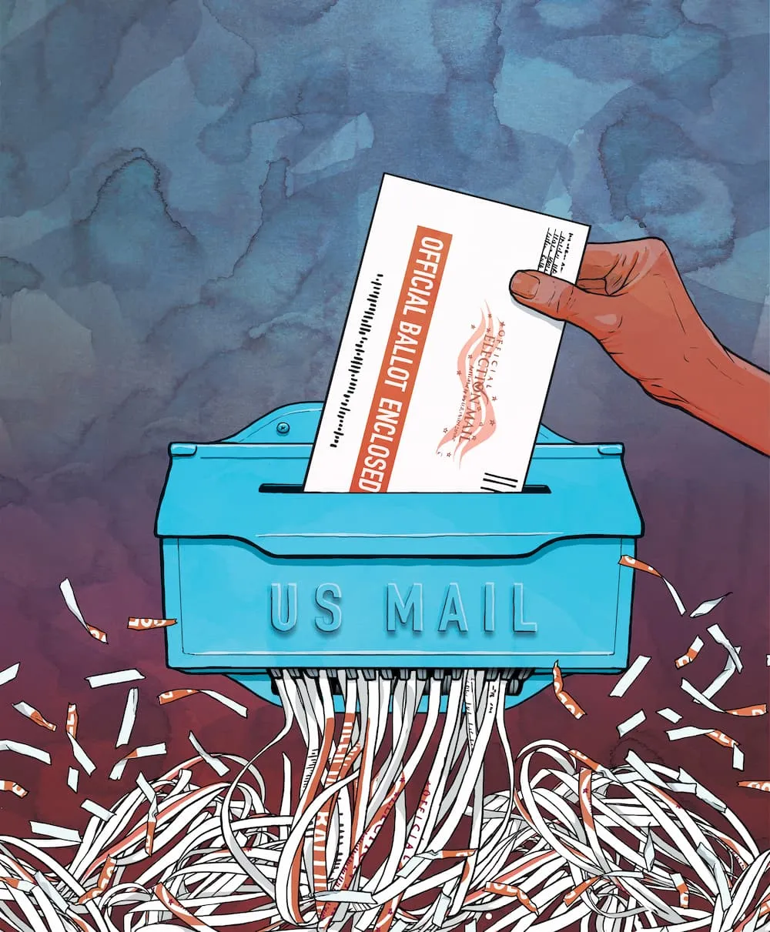

Analyzing Rejected and Undeliverable Ballots in California's 2025 Special Election
ESRA 2026
Michael Herndon
PhD Candidate UCLA Political Science

Slide 2
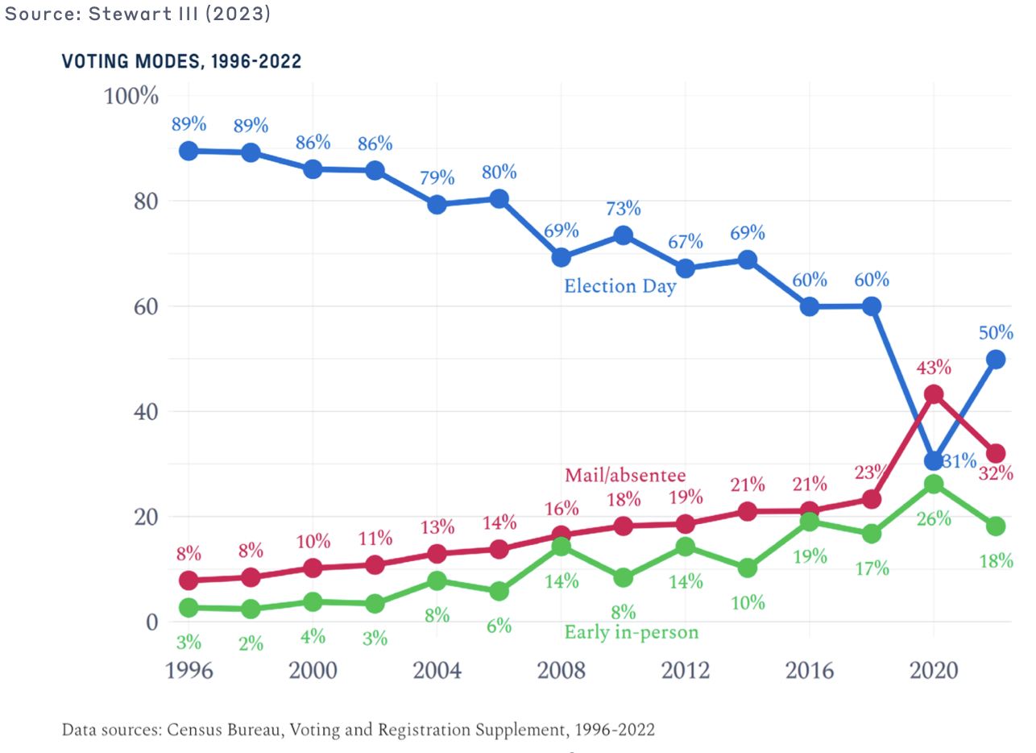
8 All-mail States & DC
28 “no-excuse” States
Notes:
We as a country are embracing voting by mail more and more, and especially in the west coast where several states have universal vote by mail. Overall I think this is a good thing because it is shown to increase turnout.
HOWEVER, the process of VBM is not perfect, there are flaws. The main obstacle that I will talk about in this talk is that because voters are not physically present to verify their identity in a polling place, it has to be verified remotely, which can be tricky and leads to millions of rejected VBM ballots.
8 states conduct elections all-mail where every registered voter is sent a VBM ballot through the mail (California, Colorado, Hawaii, Nevada, Oregon, Utah, Vermont,
and Washington)
28 states, offer “no-excuse” VBM, which means any voter can request and cast a VBM ballot, with no excuse or reason necessary, according to the National Conference of State Legislatures (NCSL).
https://electionlab.mit.edu/sites/default/files/2023-10/vote-by-mail.pdf

Slide 3
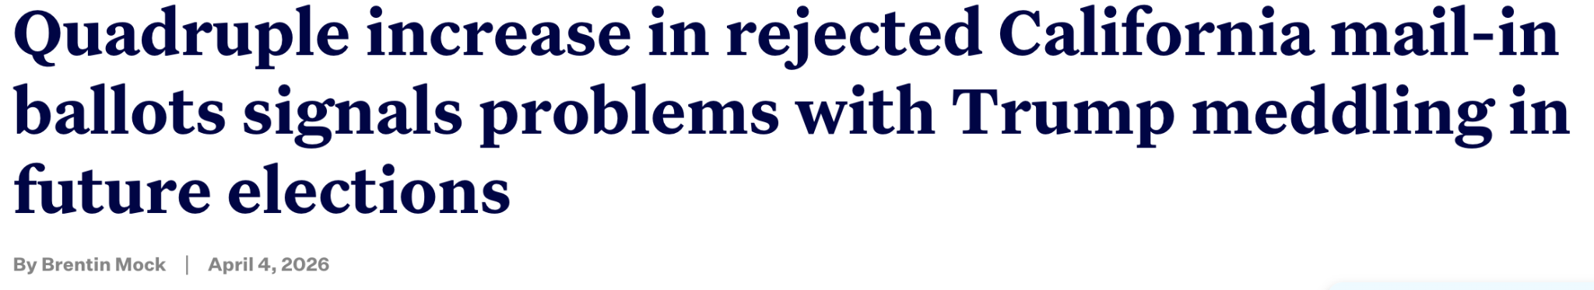
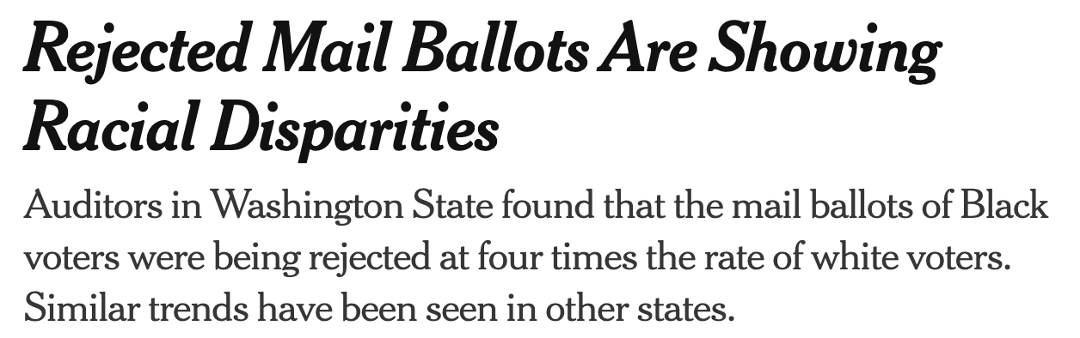
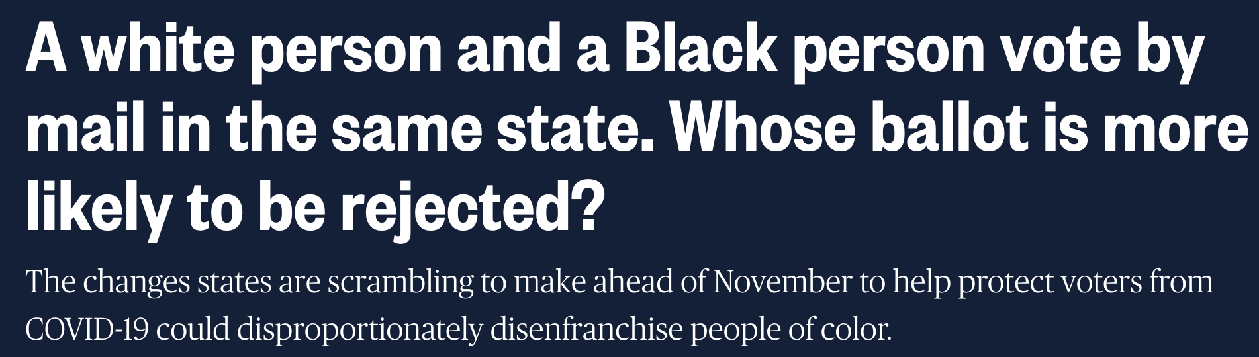

Slide 4
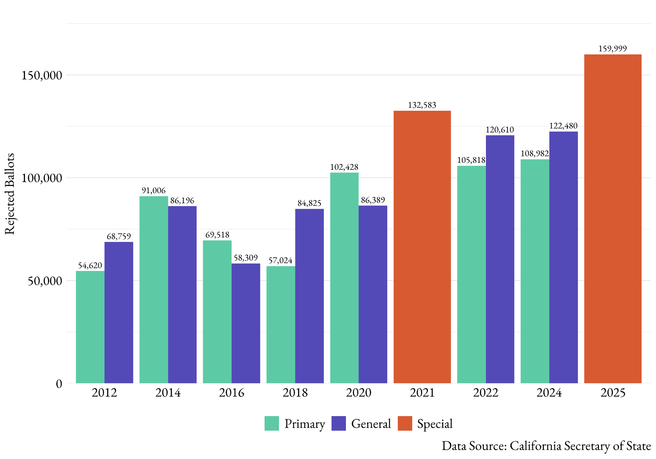
Total Ballot Rejection in California: 2012-2025

Slide 5
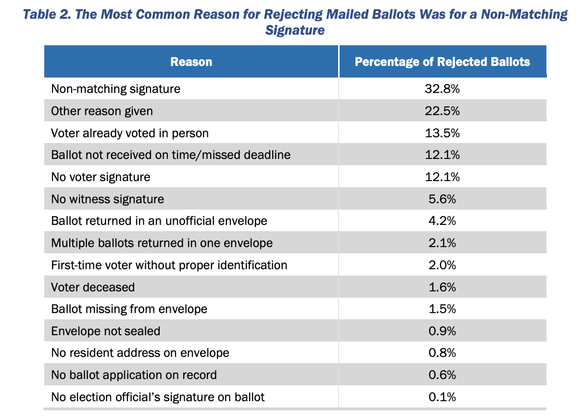
Breakdown of Rejected Ballot Reasons - 2020

Slide 6
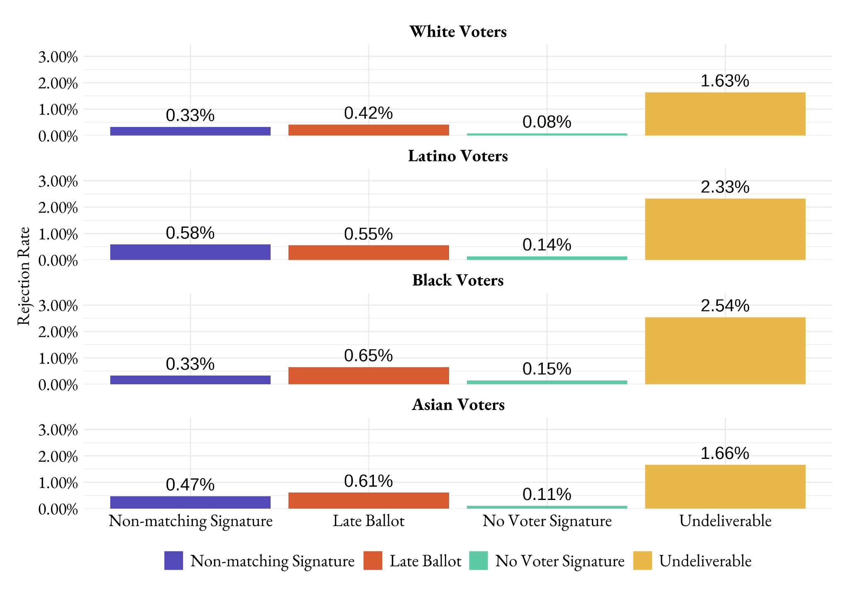
California ballot rejection reasons in 2022 general election.

Slide 7
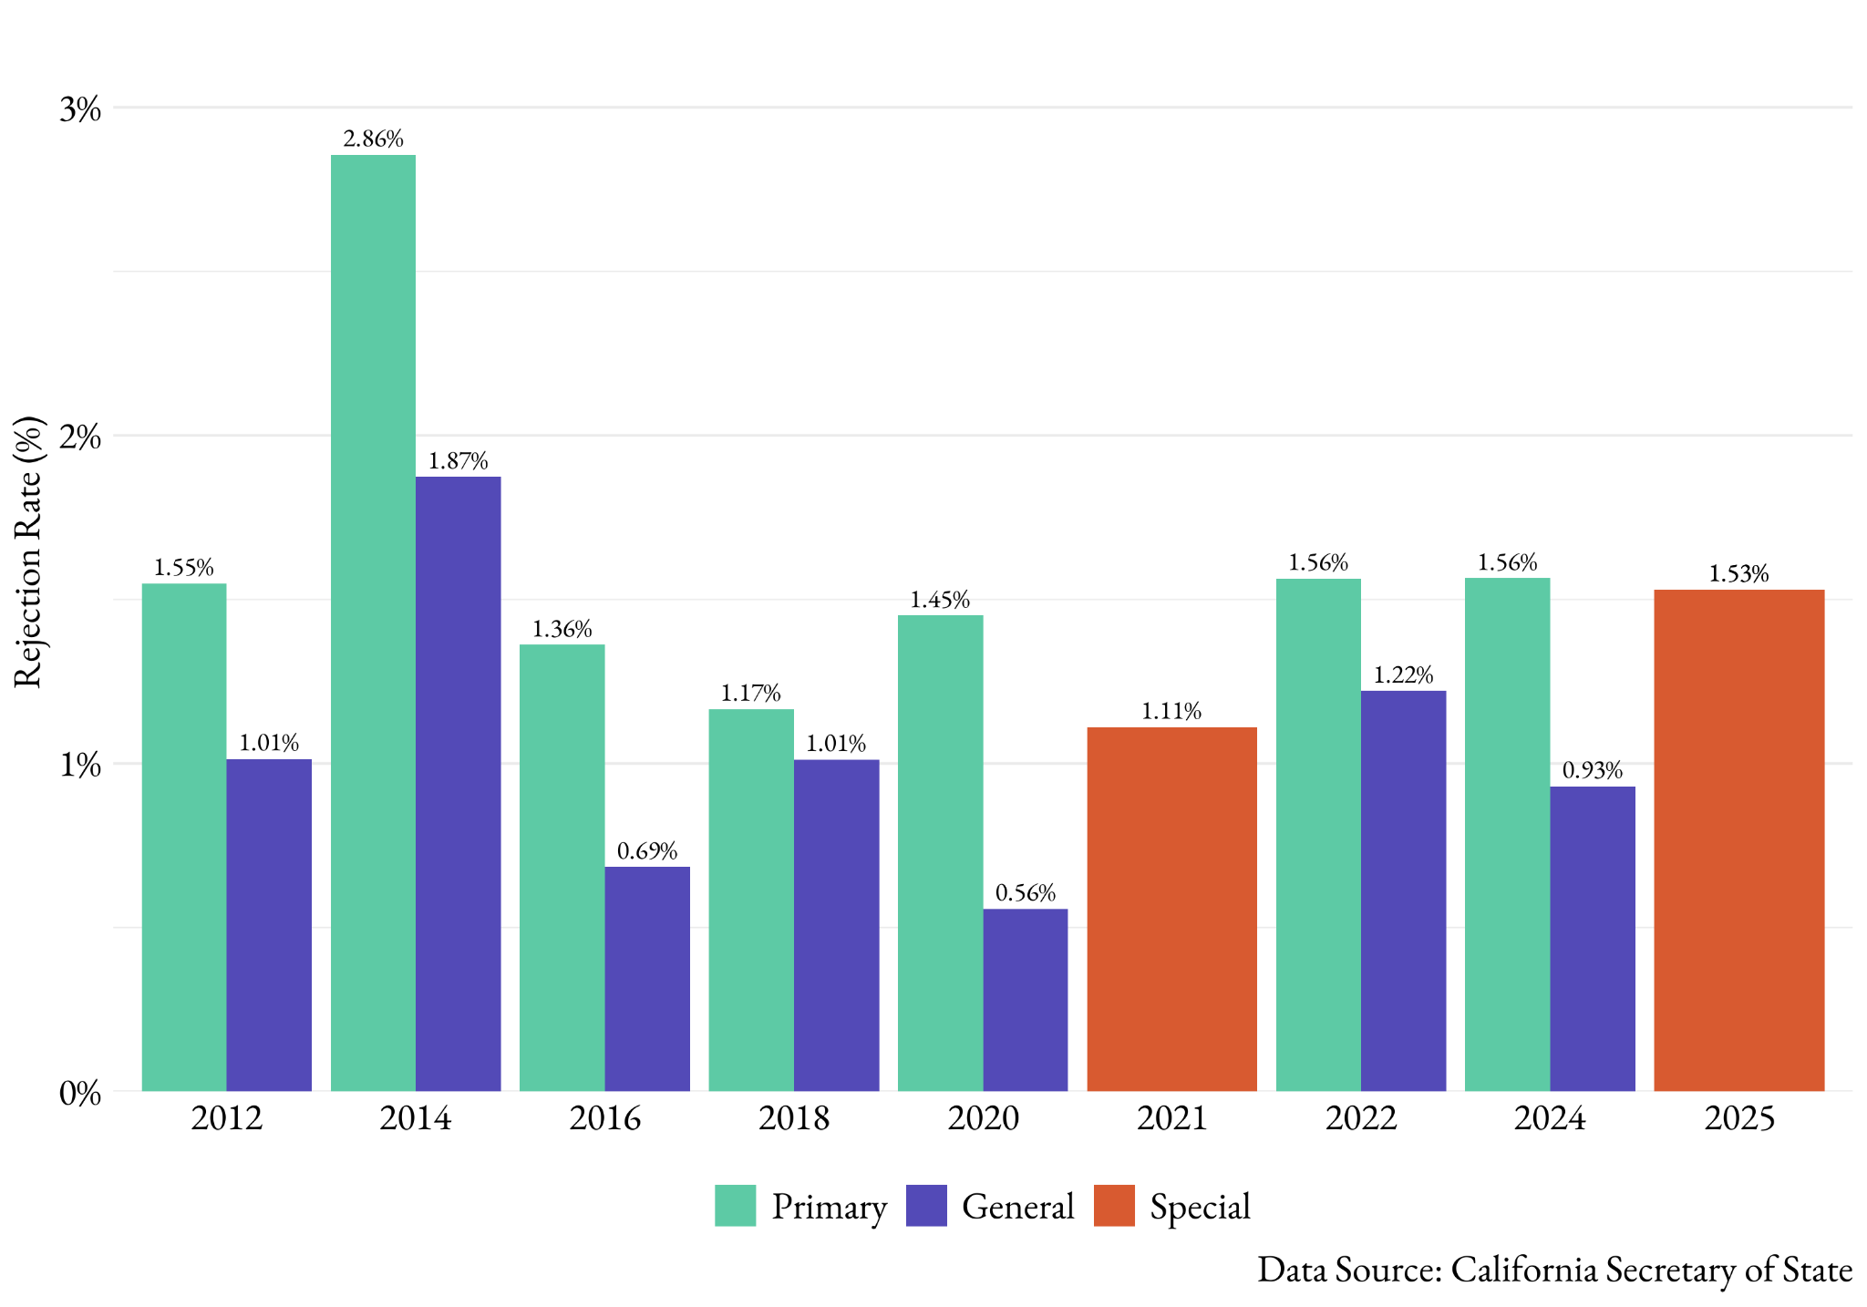
Ballot Rejection Rate in California: 2012-2025

Slide 8
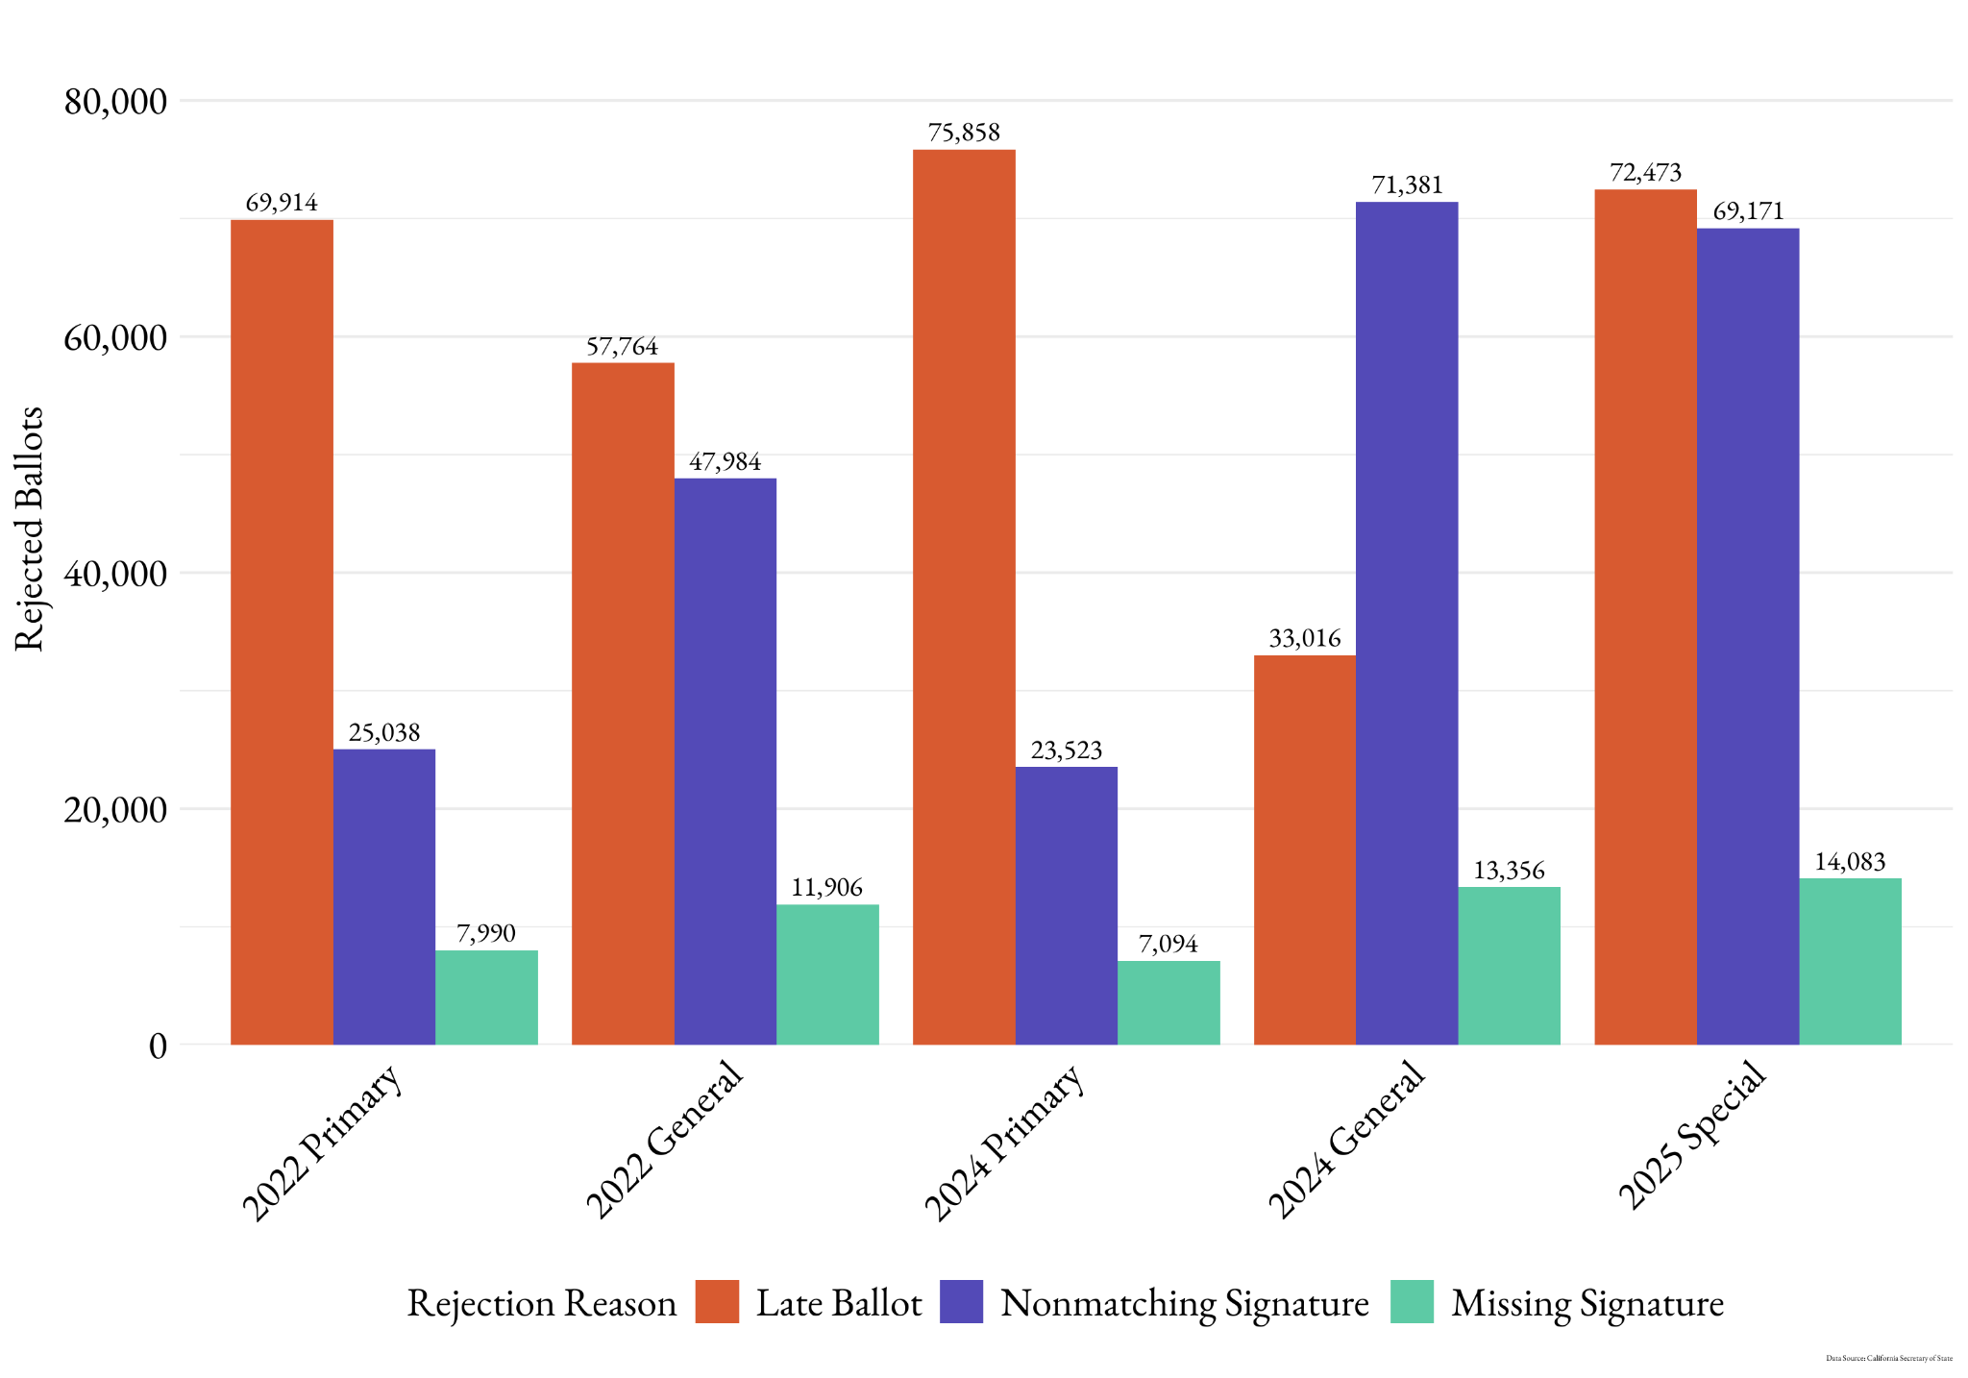
Ballot Rejection Reasons in California: 2012-2025

Slide 9
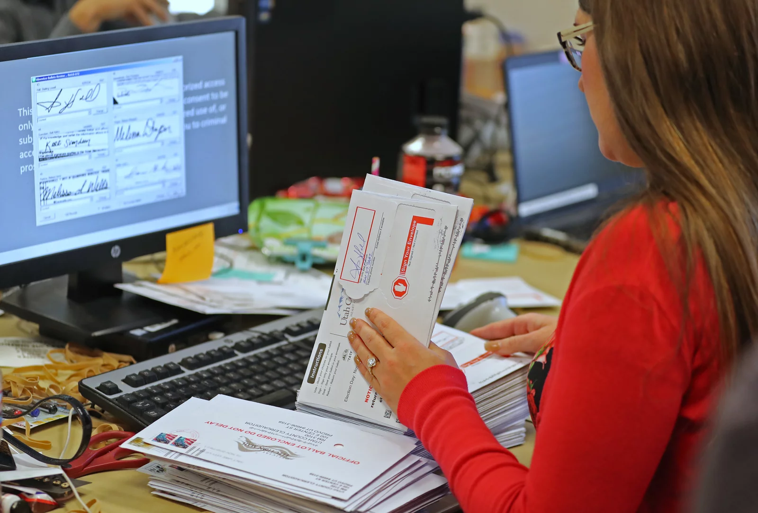
Research Questions
What were the race and age disparities in ballot rejection for California’s 2025 special election on prop 50?
How did these disparities differ across signature rejection, late rejection, and undeliverable ballots?
Notes:
To answer these questions, I think it is best to create my own data using experiments. This lets me isolate one feature at a time, something that the analysis of voter files does not allow for.

Slide 10
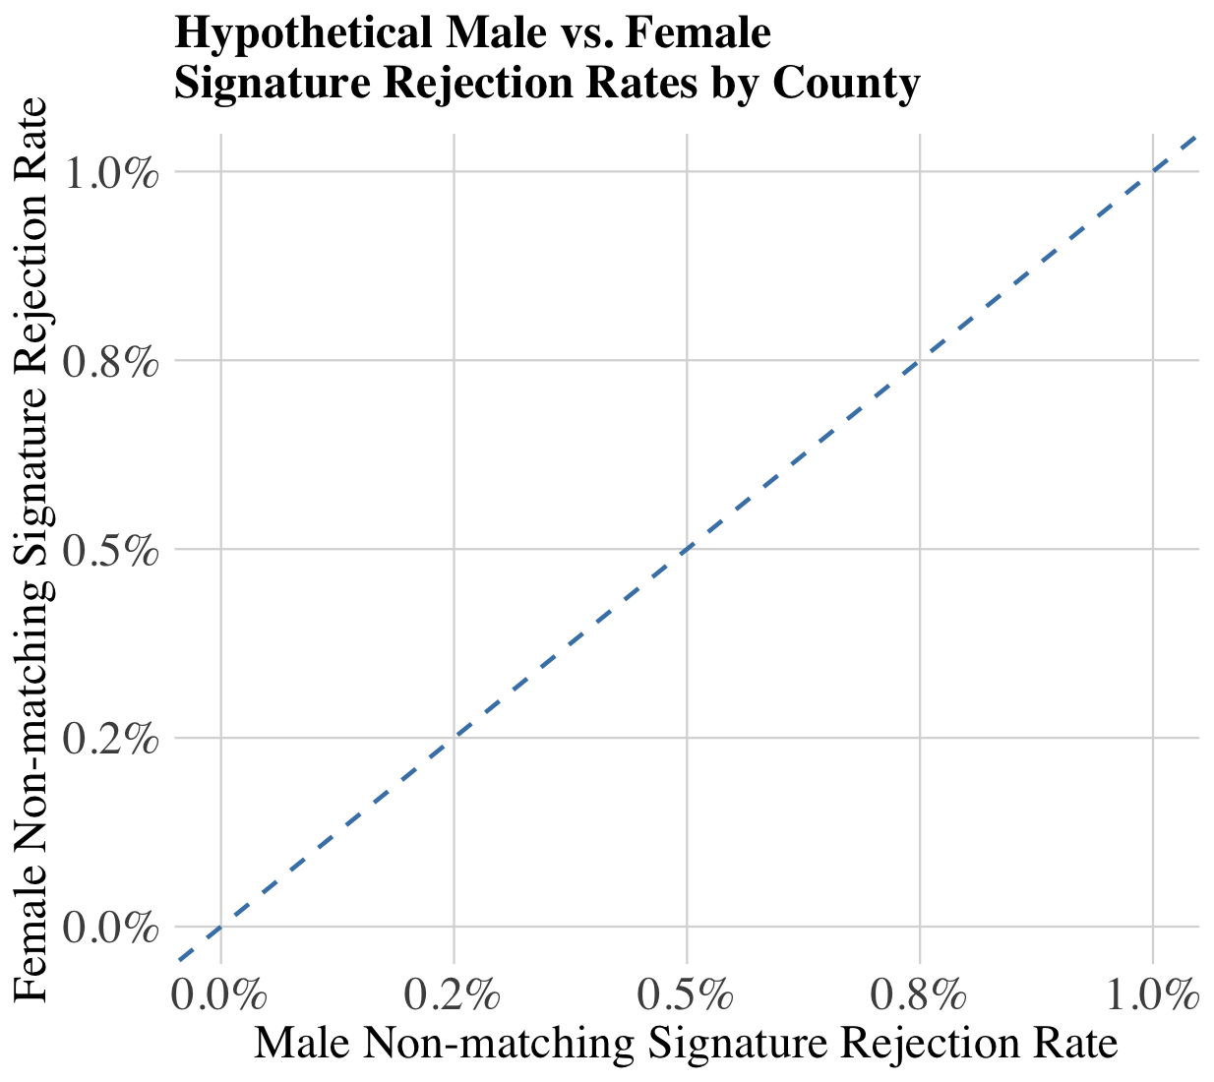
Gender as a Benchmark for Equitable Ballot Rejection
Using data from the California Secretary of State’s Office I calculated:
Signature rejection rates for male and female voters.
H1: Male and female voters are equally likely to have their VBM signature rejected.
Notes:
The WA state auditor would have us believe that the cultural barriers of Hispanic voters preclude them from signing correctly, but not from submitting a ballot on time. While this is plausible, it is more likely that bureaucratic bias is affecting signature verification.

Slide 11
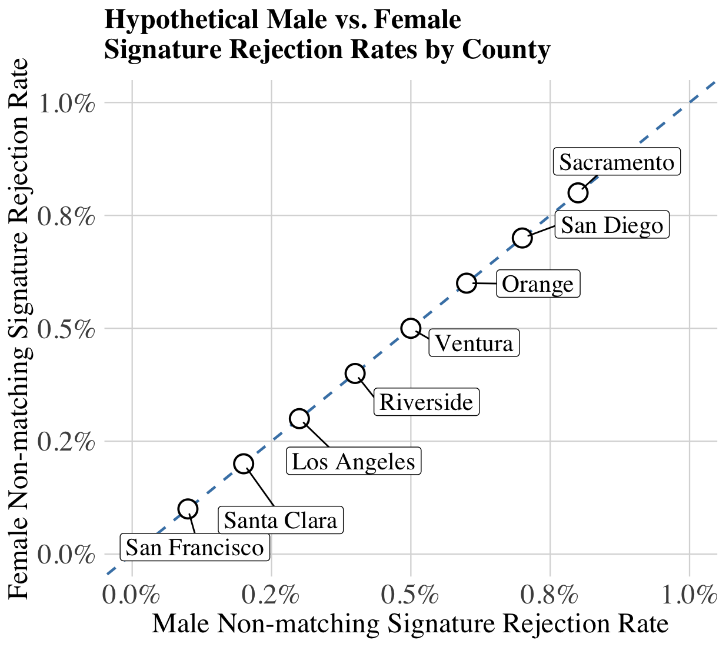
Gender as a Benchmark for Equitable Ballot Rejection
Using data from the California Secretary of State’s Office I calculated:
Signature rejection rates for male and female voters.
H1: Male and female voters are equally likely to have their VBM signature rejected.
Notes:
The WA state auditor would have us believe that the cultural barriers of Hispanic voters preclude them from signing correctly, but not from submitting a ballot on time. While this is plausible, it is more likely that bureaucratic bias is affecting signature verification.

Slide 12
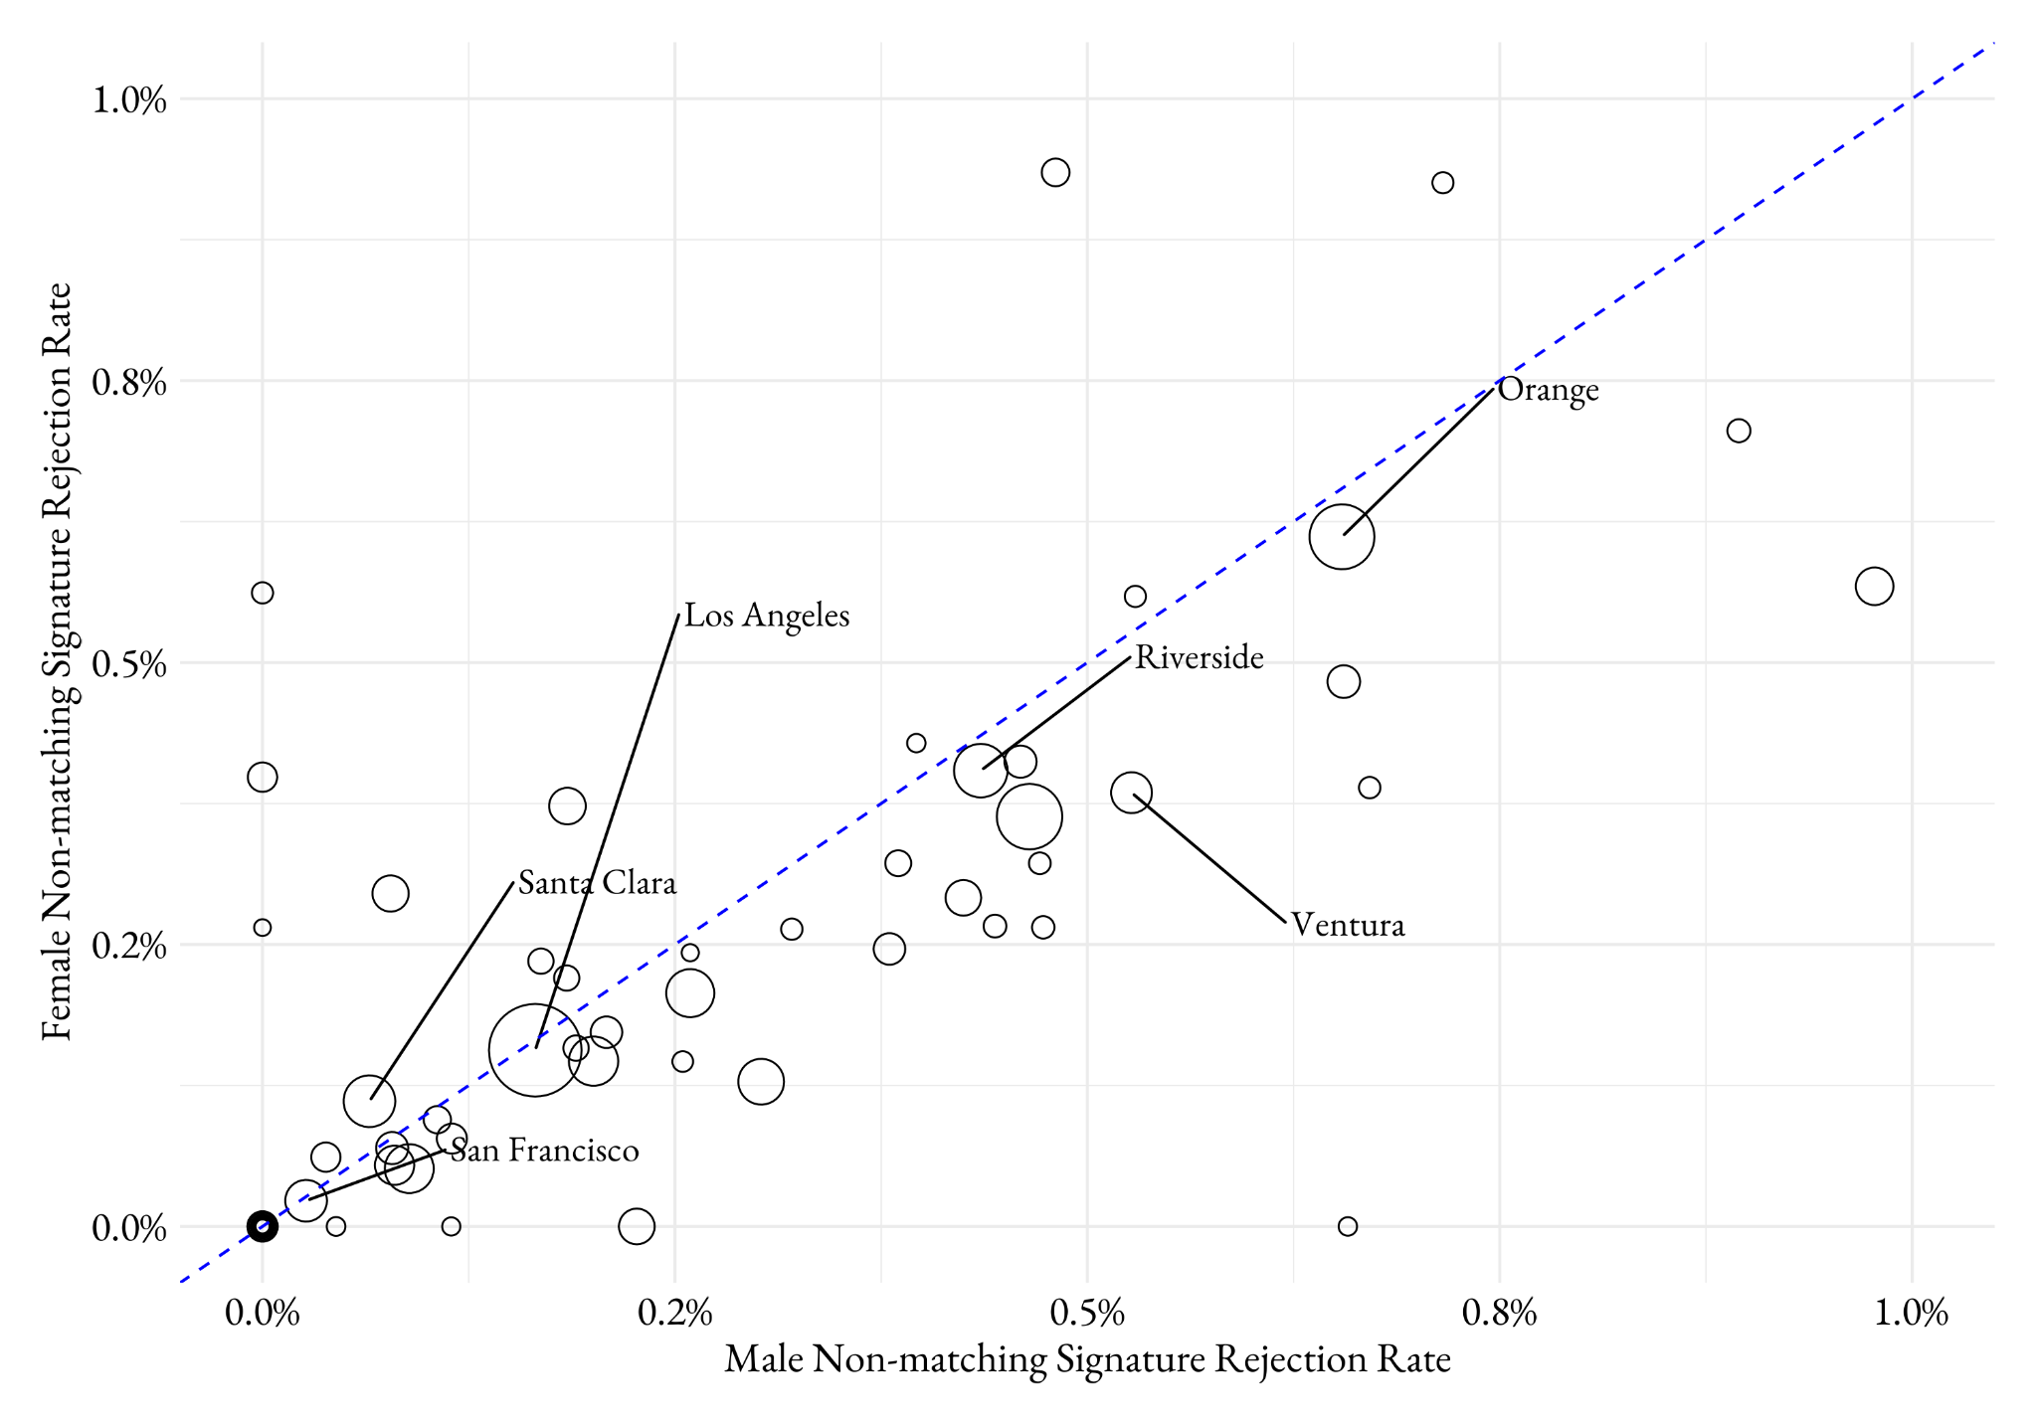
Gender as a Benchmark for Equitable Ballot Rejection
Using data from the California Secretary of State’s Office I calculated:
Signature rejection rates for male and female voters.
H1: Male and female voters are equally likely to have their VBM signature rejected.
Notes:
The WA state auditor would have us believe that the cultural barriers of Hispanic voters preclude them from signing correctly, but not from submitting a ballot on time. While this is plausible, it is more likely that bureaucratic bias is affecting signature verification.

Slide 13
Hypotheses
Using 2025 election data from the California Secretary of State’s Office I predict:
H1: Non-White voters are more likely to experience ballot rejection for signature mismatch, late submission and undeliverable ballots compared to White voters.
H2: Younger voters are more likely to experience ballot rejection for signature mismatch, late submission and undeliverable ballots compared to older voters.
Notes:
The WA state auditor would have us believe that the cultural barriers of Hispanic voters preclude them from signing correctly, but not from submitting a ballot on time. While this is plausible, it is more likely that bureaucratic bias is affecting signature verification.

Slide 14
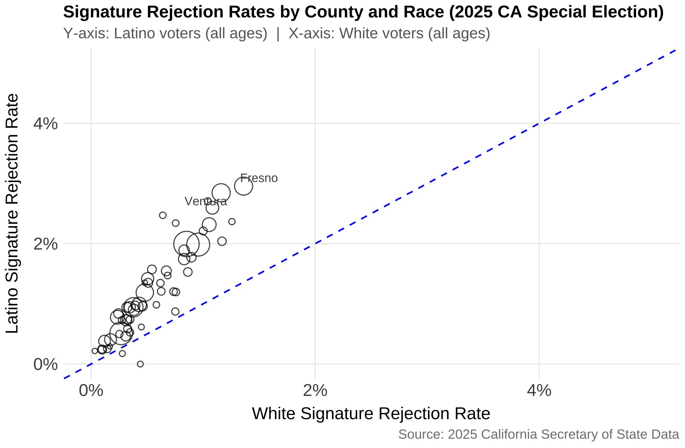

Slide 15
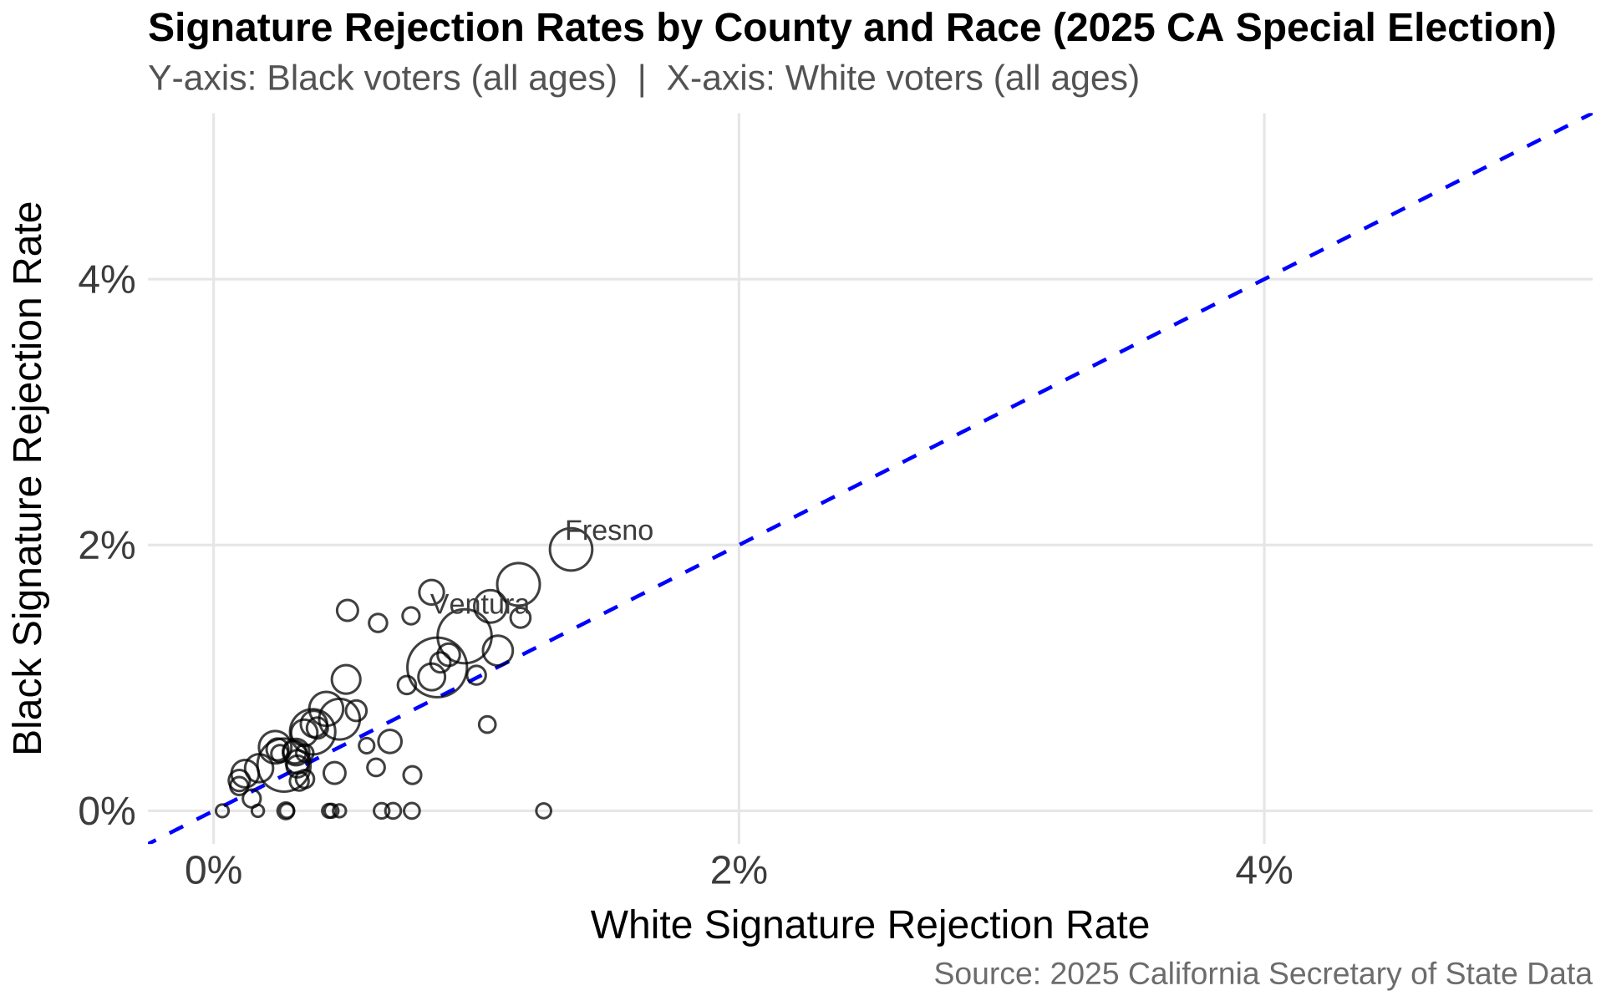

Slide 16
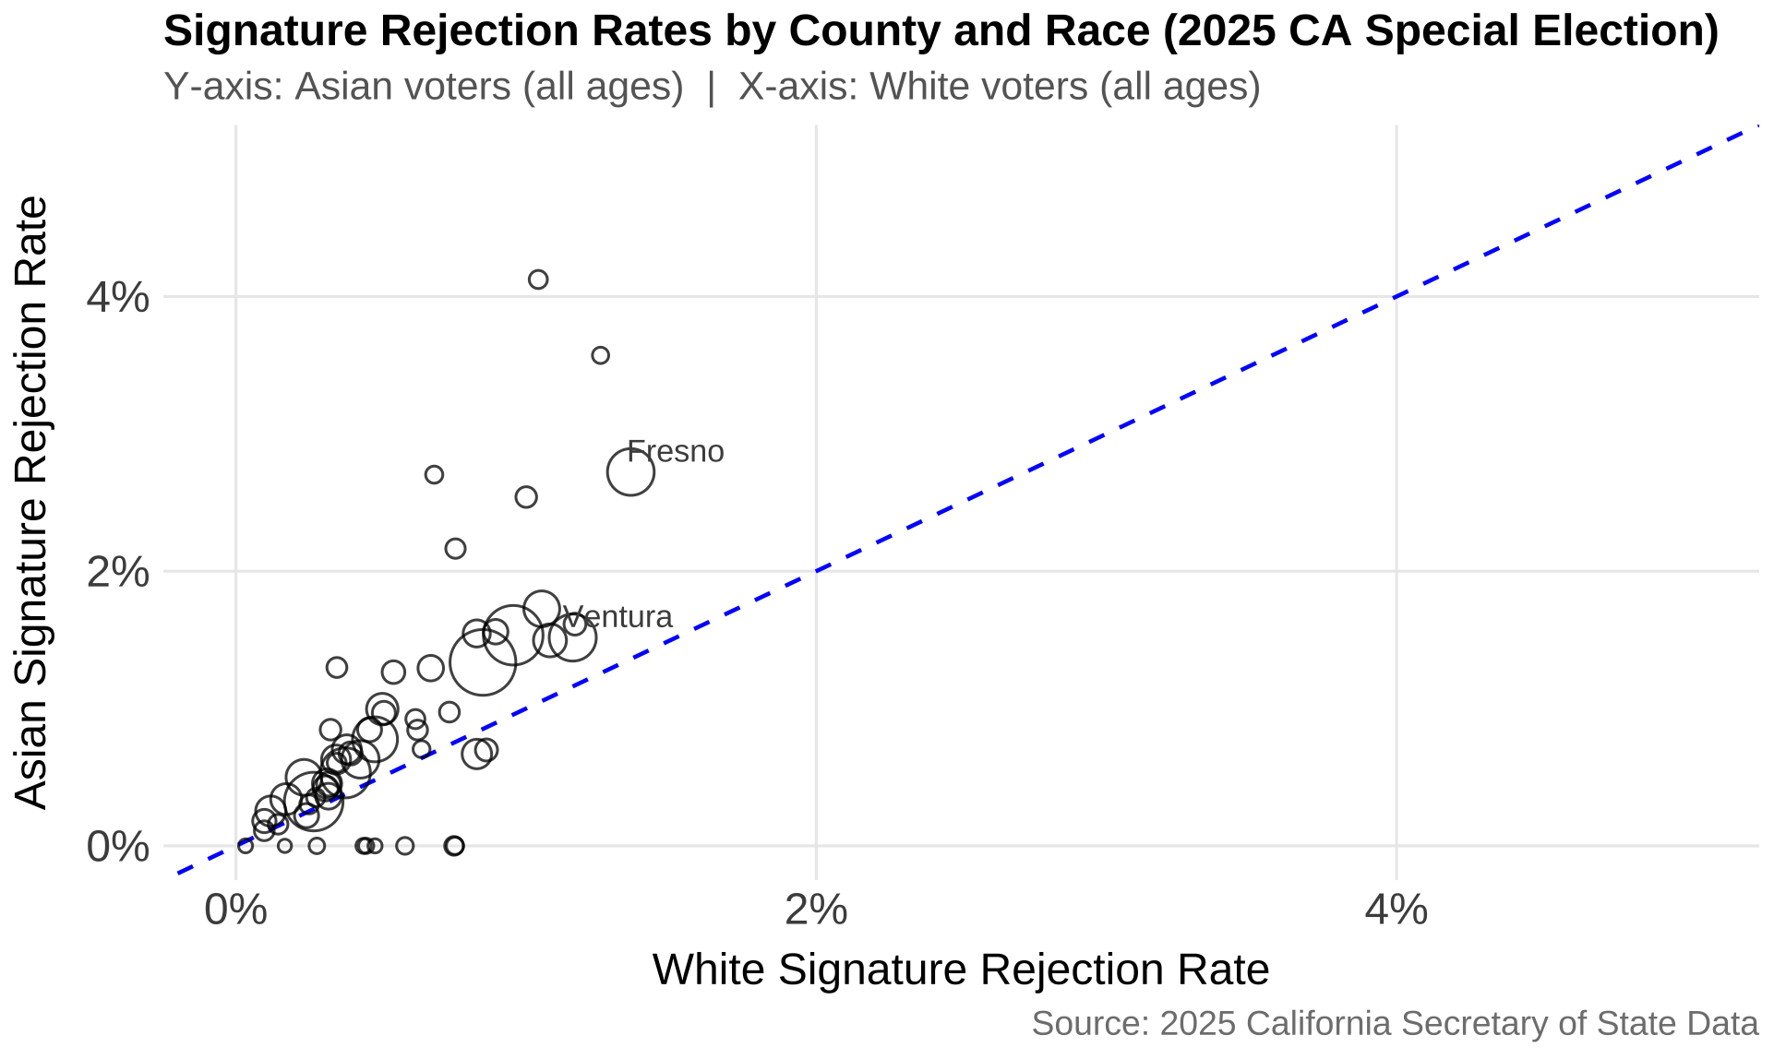

Slide 17
LATE REJECTION BY RACE
LATINO VS. WHITE
BLACK VS. WHITE
ASIAN VS. WHITE

Slide 18
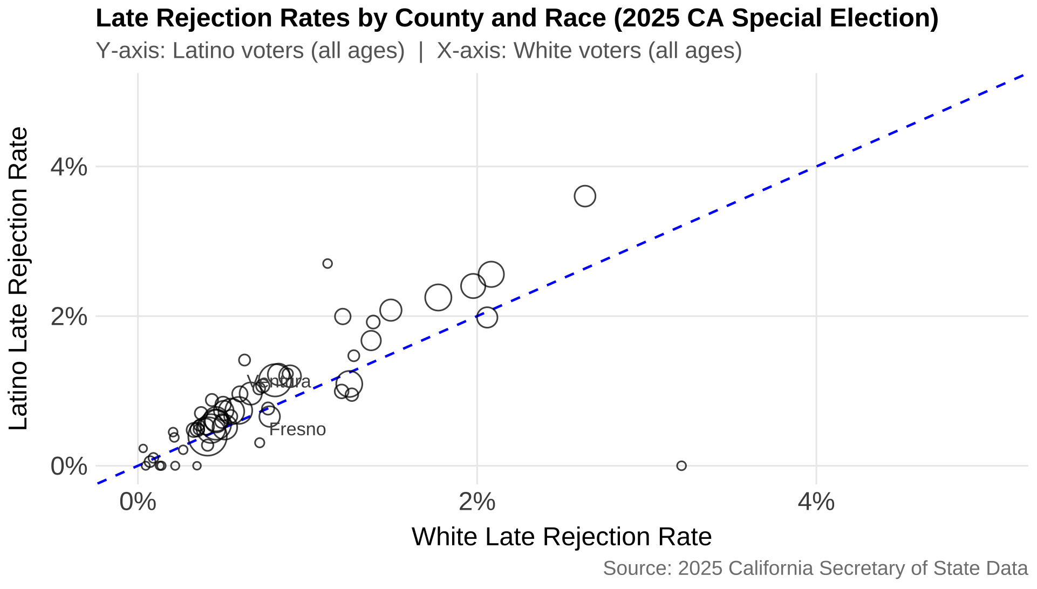

Slide 19
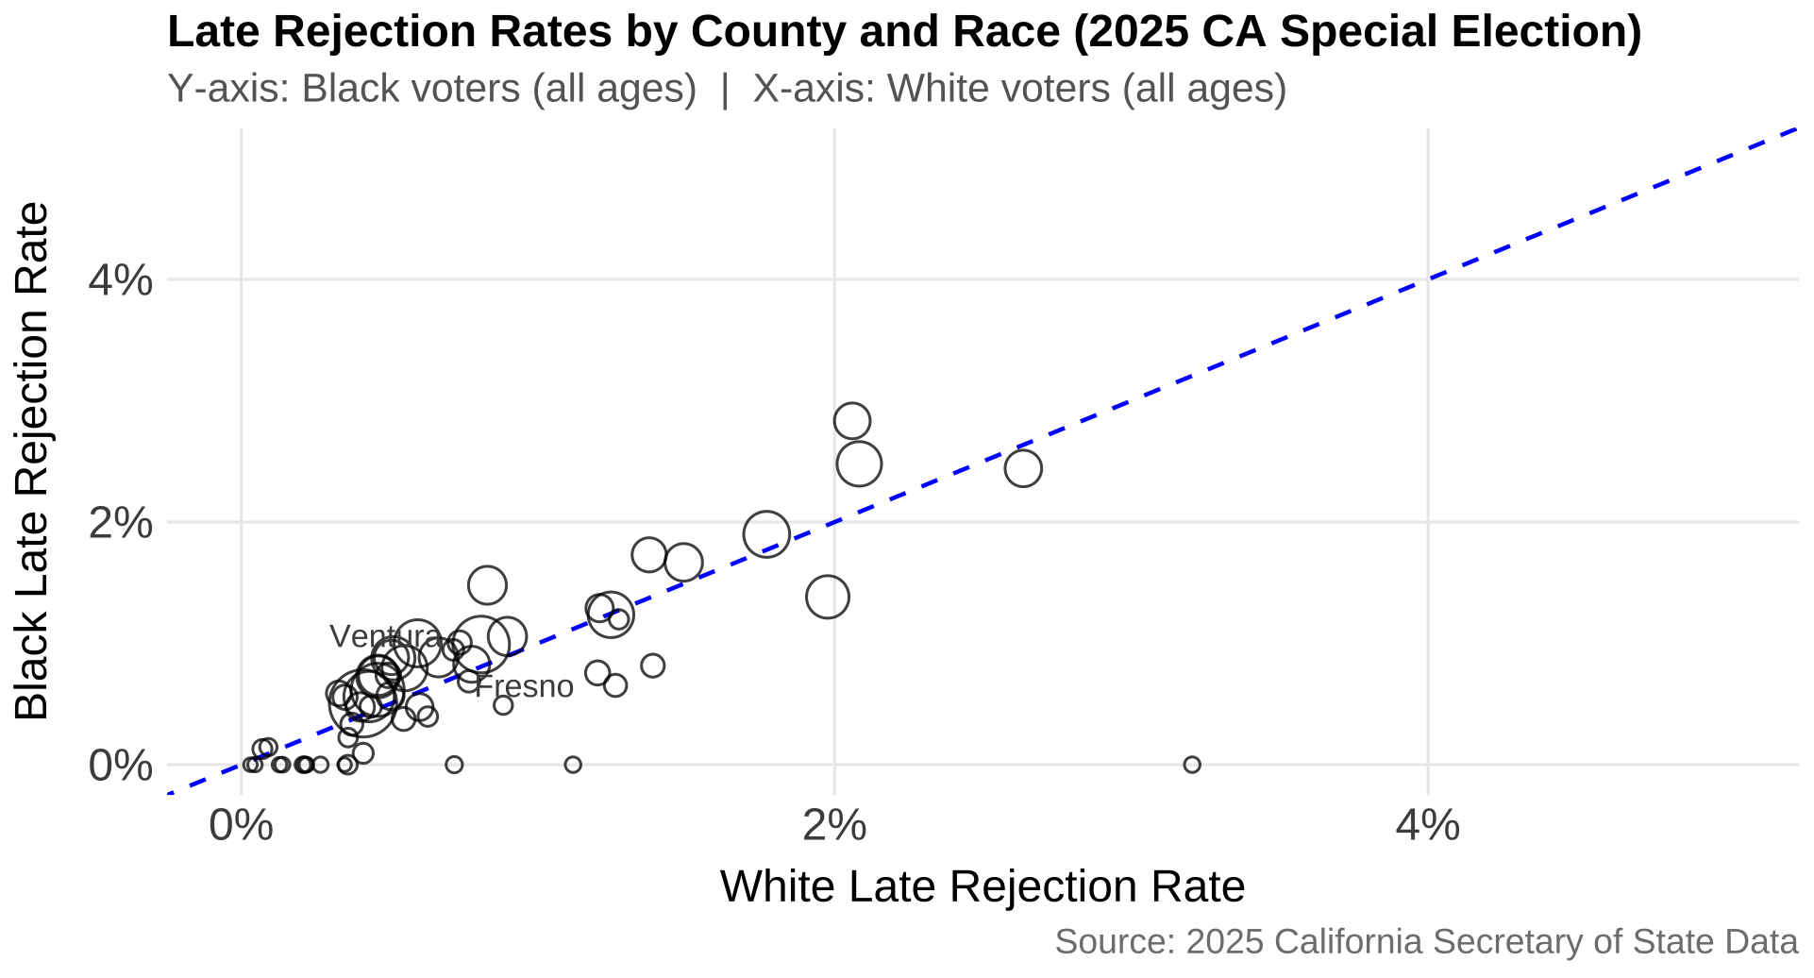

Slide 20
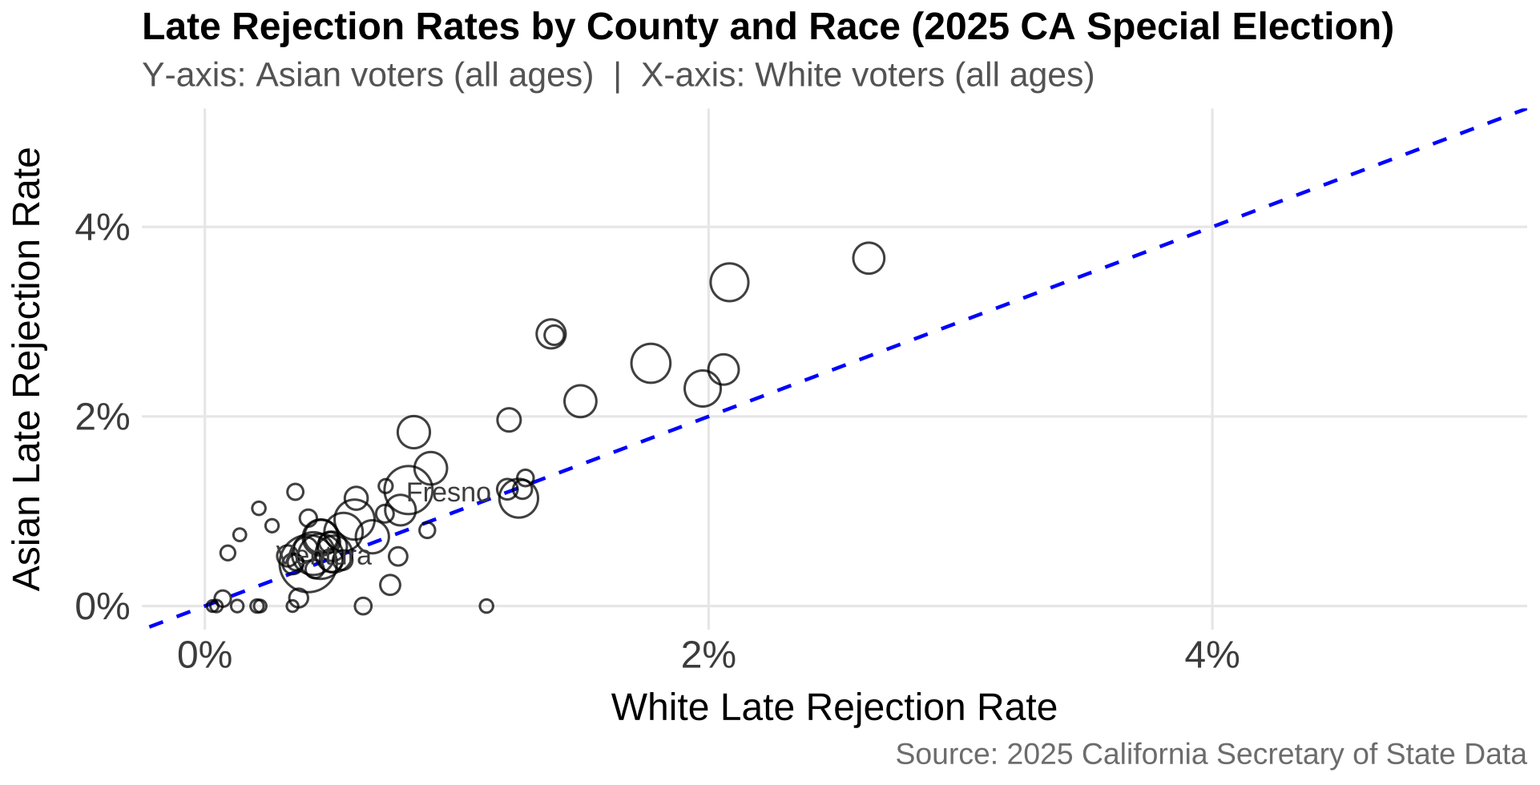

Slide 21
UNDELIVERABLE BALLOTS BY RACE
LATINO VS. WHITE
BLACK VS. WHITE
ASIAN VS. WHITE

Slide 22
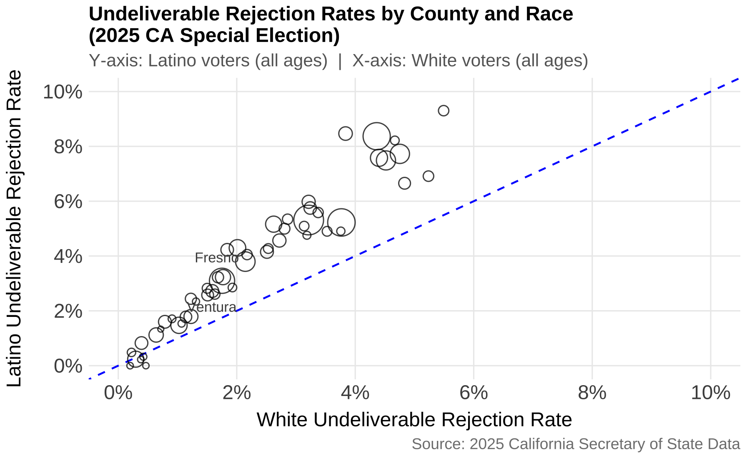

Slide 23
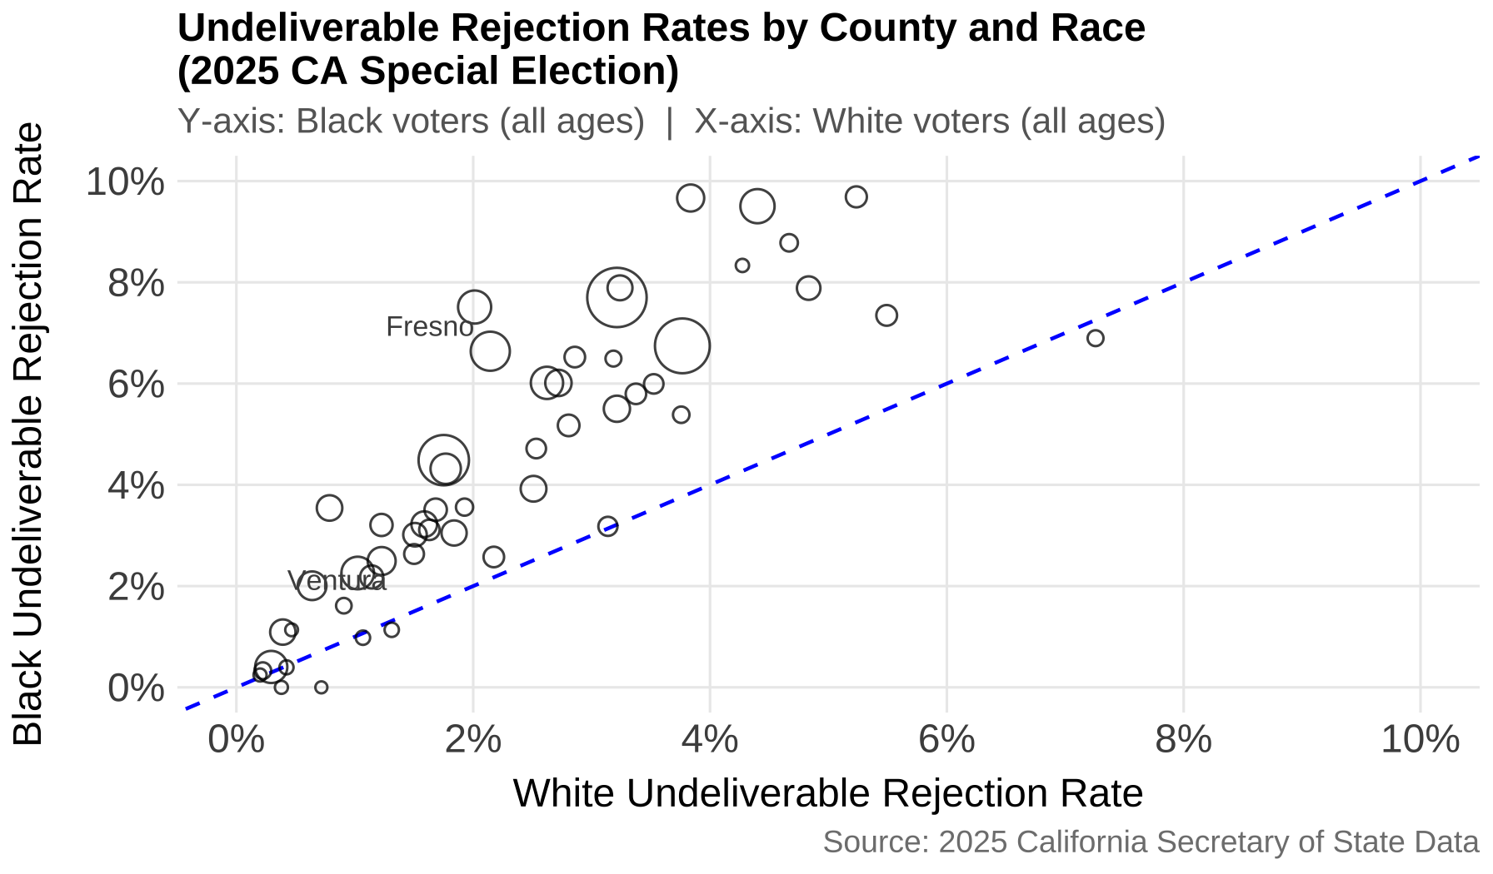

Slide 24
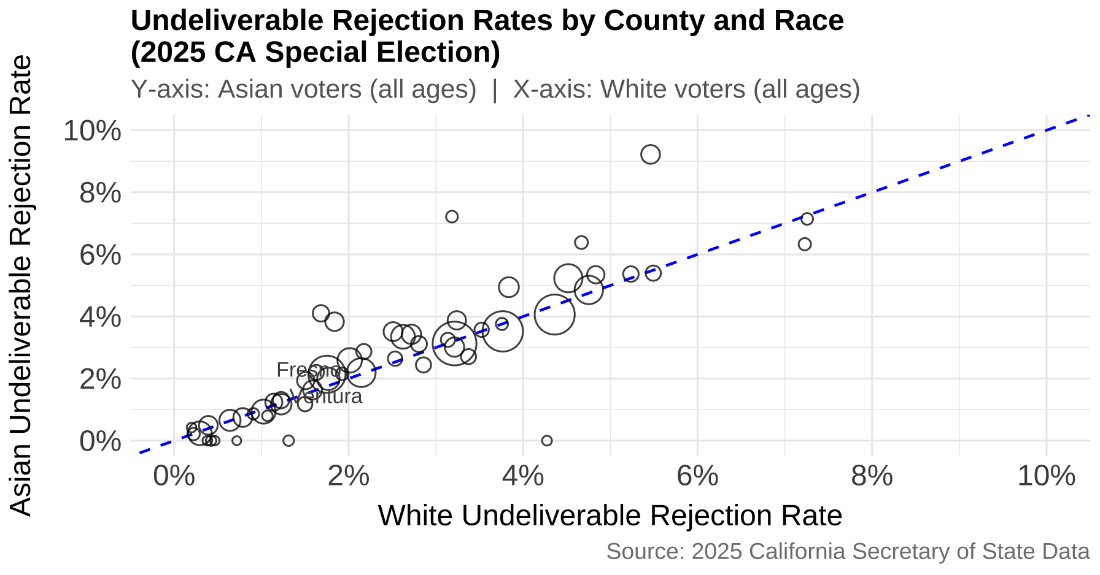

Slide 25
SIGNATURE REJECTION BY RACE AND AGE
LATINO VS. WHITE
BLACK VS. WHITE
ASIAN VS. WHITE

Slide 26
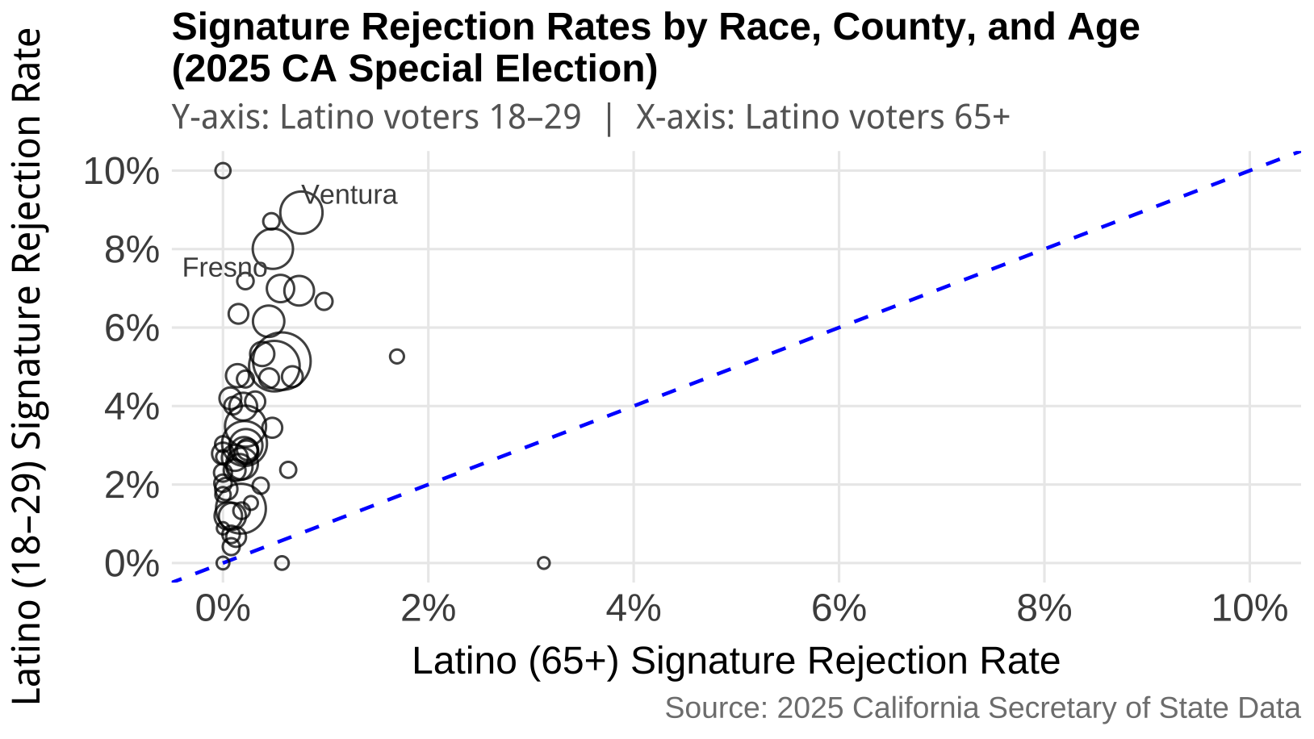

Slide 27
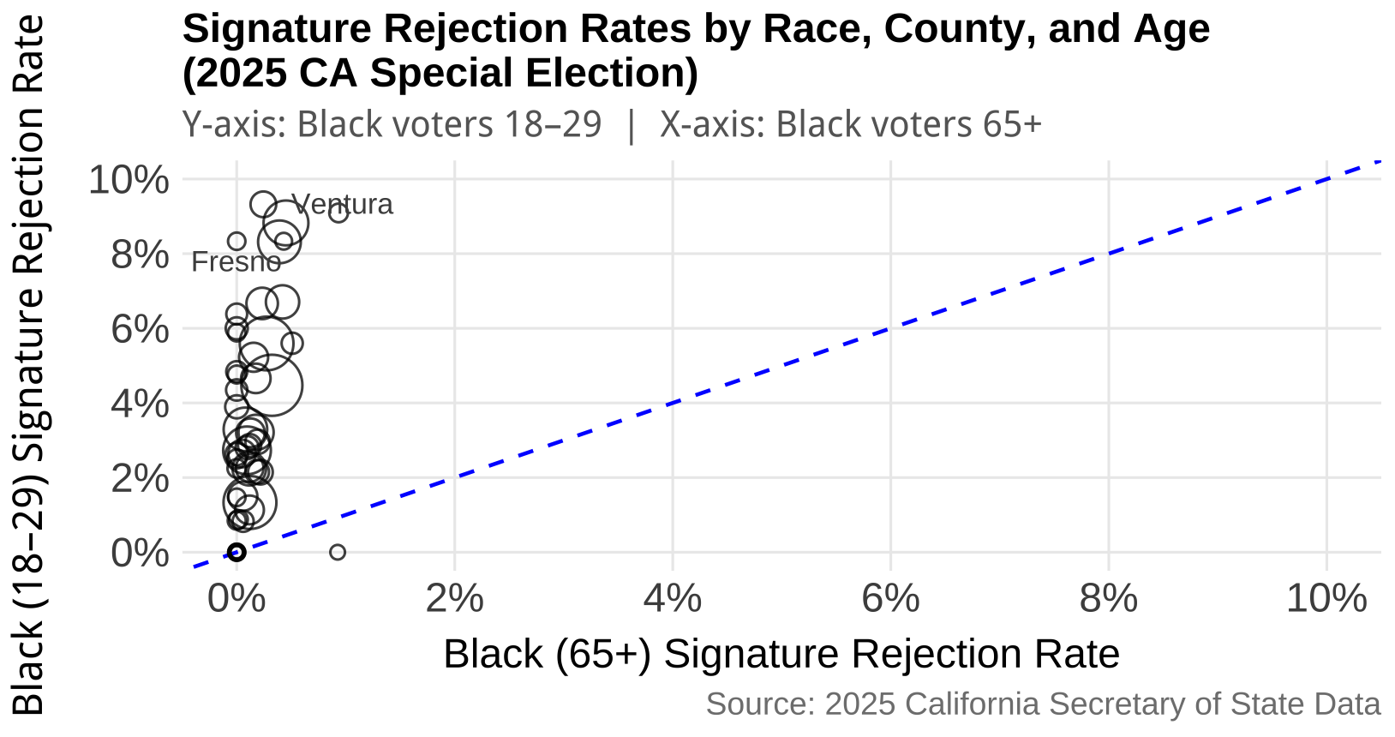

Slide 28
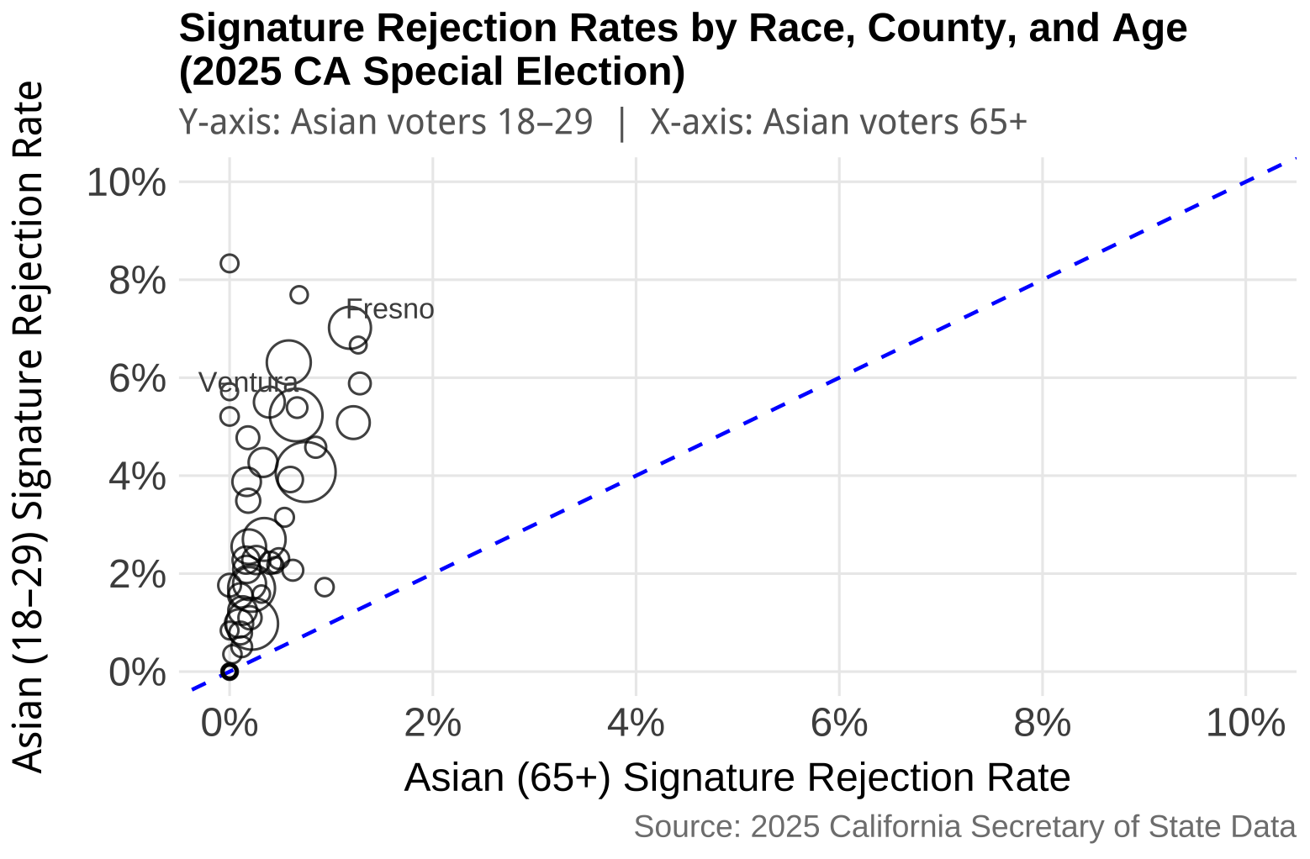

Slide 29
LATE REJECTION BY RACE AND AGE
LATINO VS. WHITE
BLACK VS. WHITE
ASIAN VS. WHITE

Slide 30
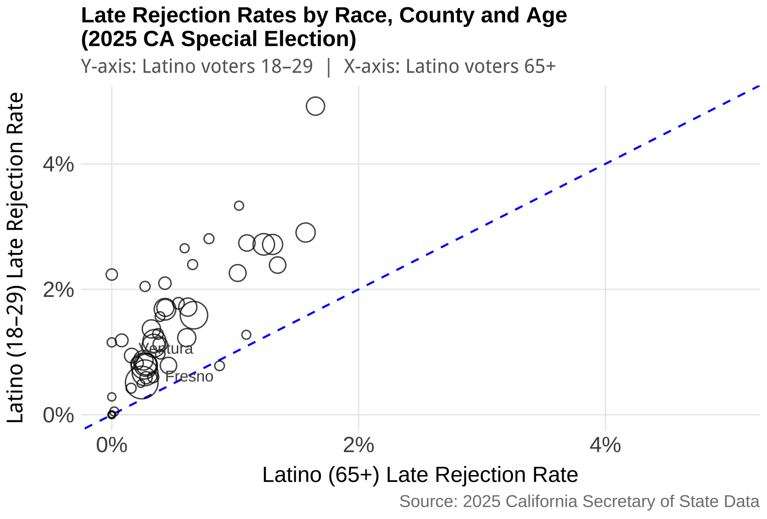

Slide 31
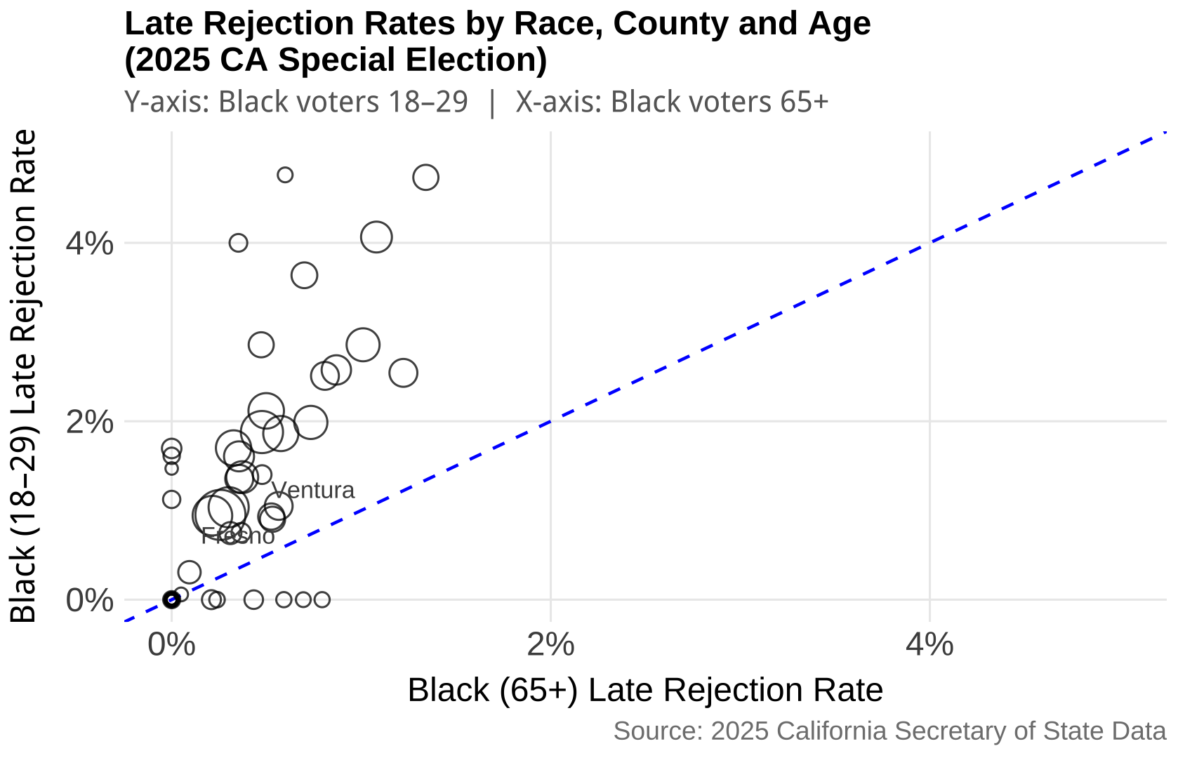

Slide 32
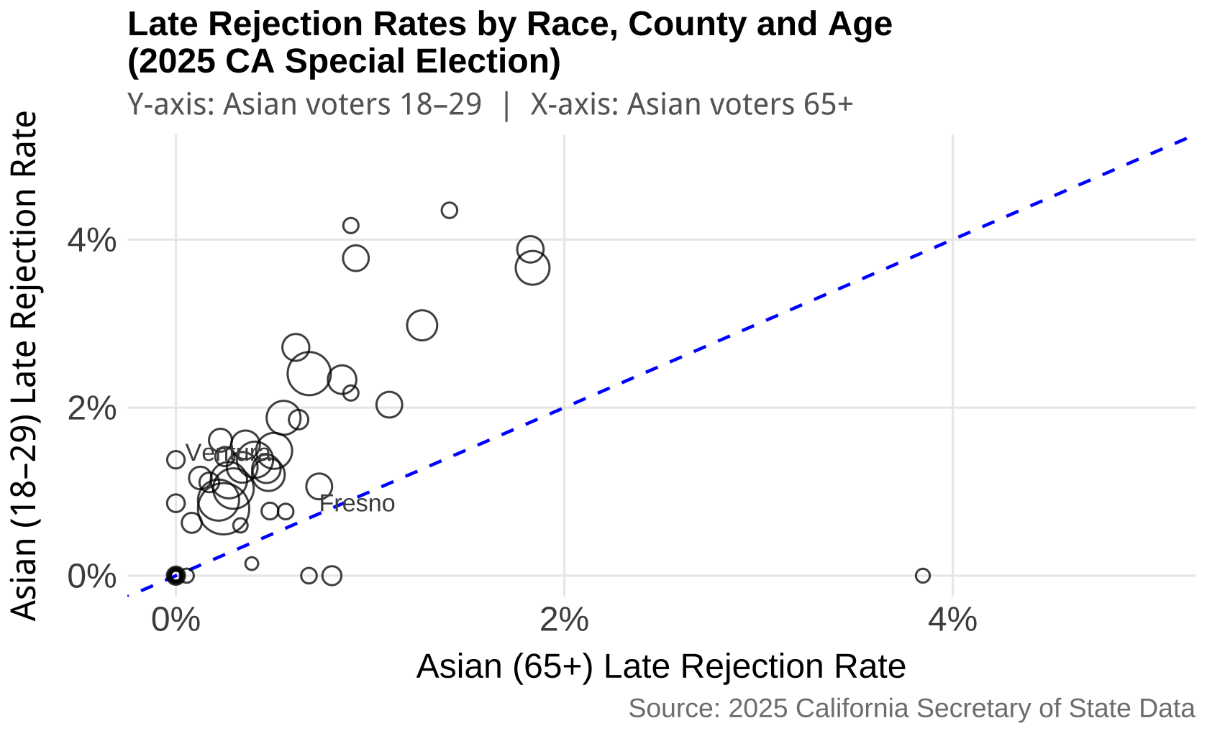

Slide 33
UNDELIVERABLE BALLOTS BY RACE AND AGE
LATINO VS. WHITE
BLACK VS. WHITE
ASIAN VS. WHITE

Slide 34
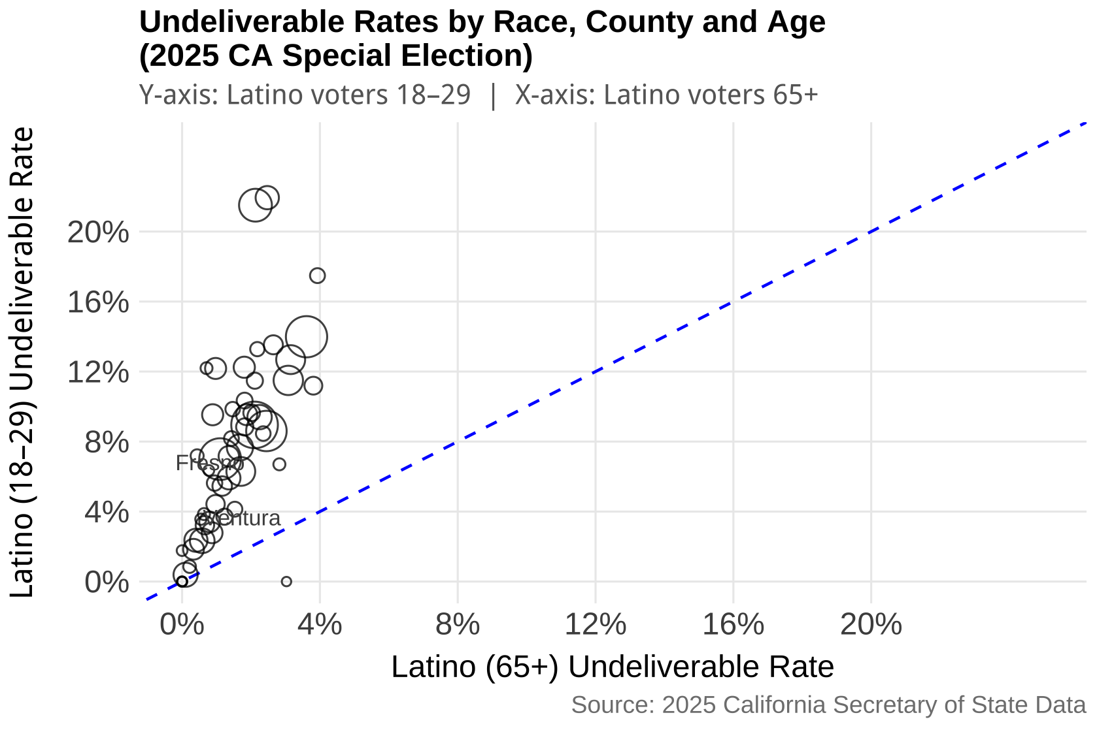

Slide 35
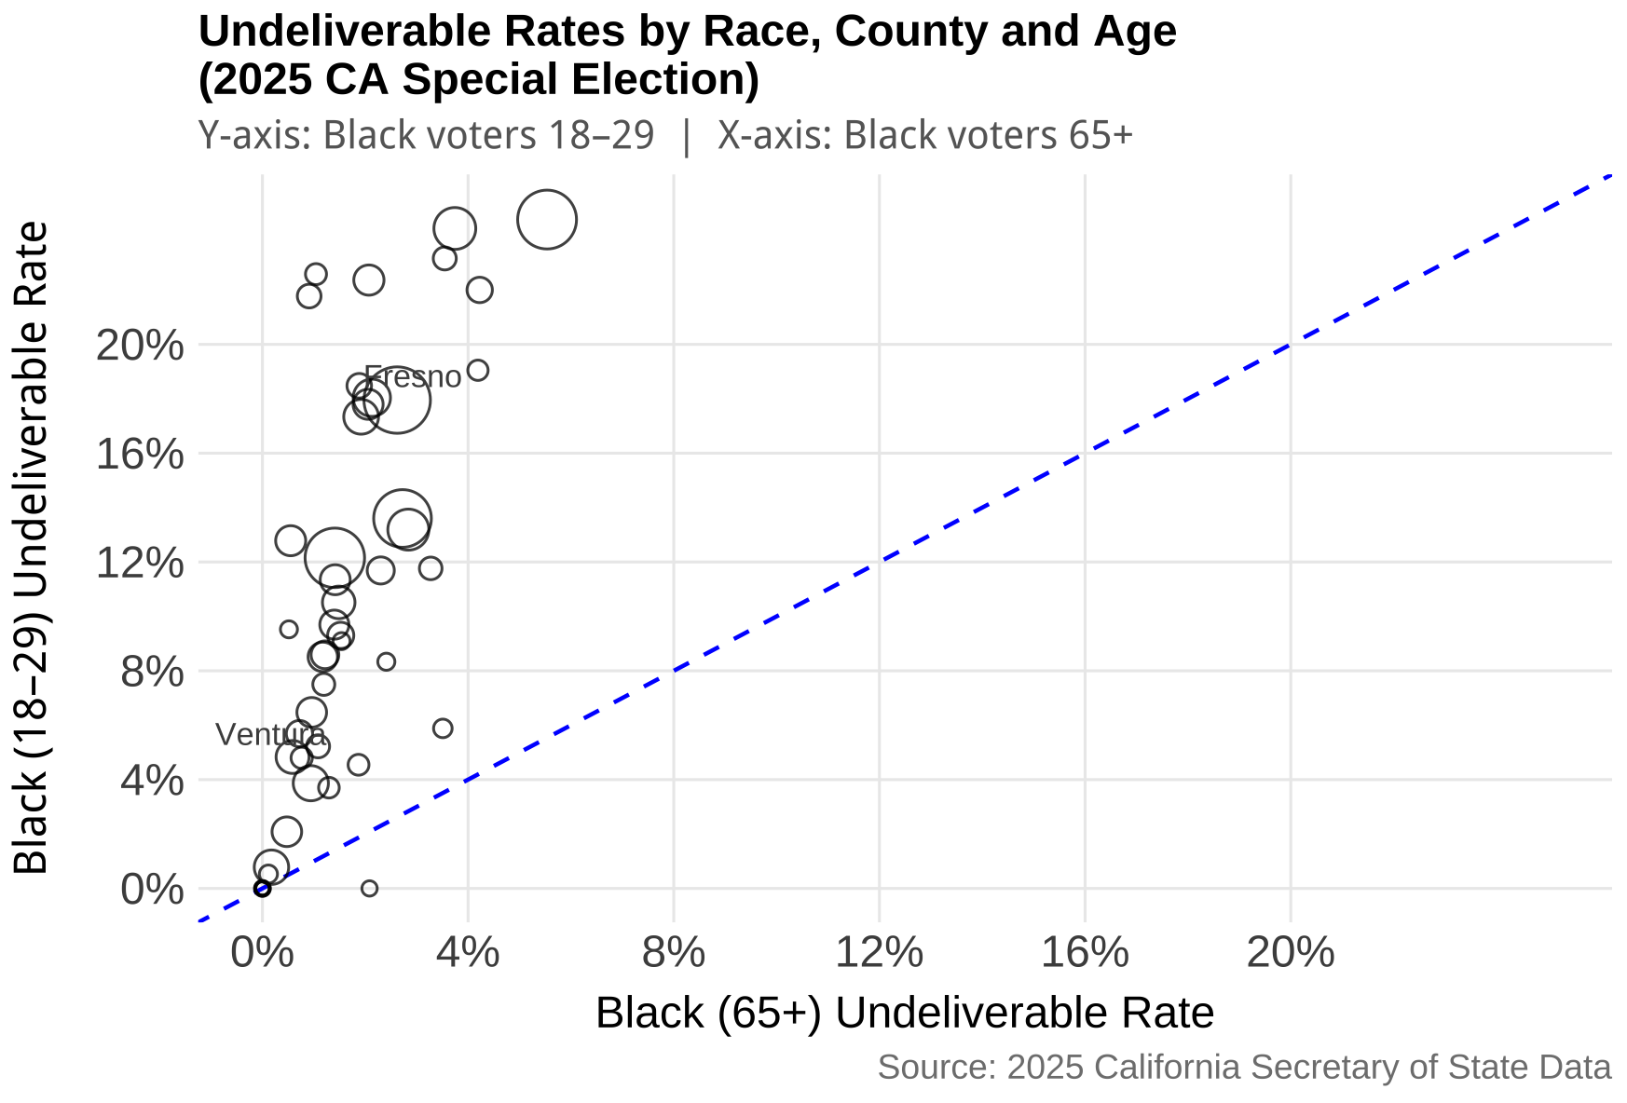

Slide 36
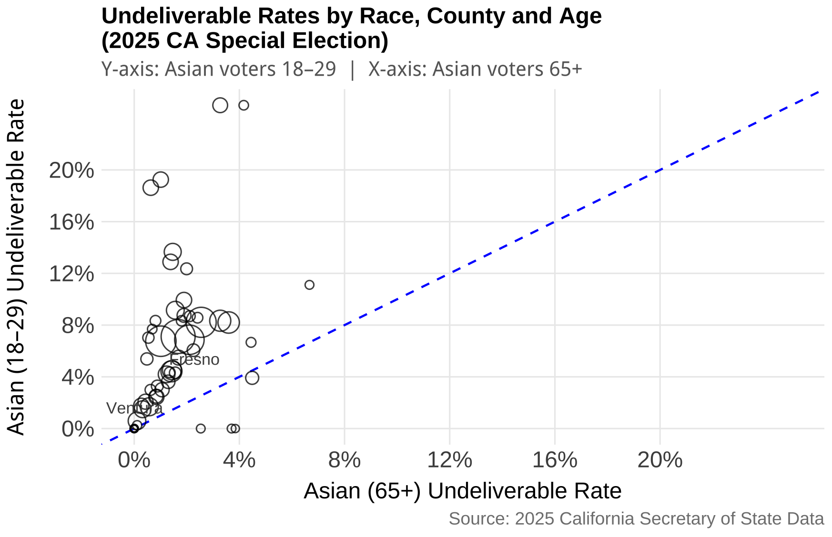

Slide 37
Conclusion
Non-White voters and especially Latinos were more likely to get their signatures rejected compared to White voters in 2025.
Non-White voters were only slightly more likely to submit a late ballot compared to White voters.
Latino and Black voters were more likely to have an undeliverable ballot than White voters.
Young voters of all races are more likely to experience ballot rejection across all reasons compared to older voters.

Slide 38
Future Research
Control for voting experience in addition to age and race
Analyze ballot rejection across more elections and states
Incorporate ballot curing rates into the analysis

